Slide 1
A Detail Study About Turkish Super League (from 93-94 to 18-19)
Mujde -R
Burcu Demirgülle - Civan Şık - Efe Demir
Furkan Sevimli - H.Nilgün Aytekin

Slide 2
A. Key Takeaways
* We have reviewed the football match statistics and Turkish football teams, in the last 25 years. The match statistics data is available on [football-data.co.uk](football-data.co.uk)
* We examined the leaguer teams for 25 years and found out how many times a team managed to attend Turkish Super League. Throughout 25 years, only 4 teams succeeded to be champion and total points of those champions fluctuates between 69-85 points interval. When we deep dived into breakdown of those points, champion teams scored more point in theır home matches than away matches. It was interesting to see how scored goals/scored points ratio varies among champions.
* We compared half season and total season rankings especially to understand journey of a leaguers in terms of stability. Especially for champions and relegated teams, half season rankings gave us a clear idea about their end results.
* We defined two new rankings as scored goal ranking and minimum conceded goal ranking alongside the classical score ranking to detail the performance of the champions. Apparently, scored goal number and conceded goal number have different weights to bring the success to the champion.
* In order to build a better understanding of the successes of the champions, we looked at their consecutive win, unbeaten and losing streaks.

Slide 3
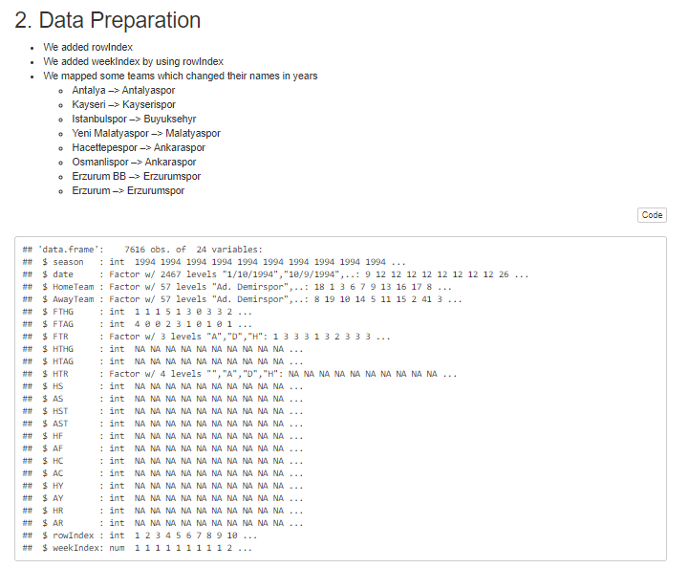

Slide 4
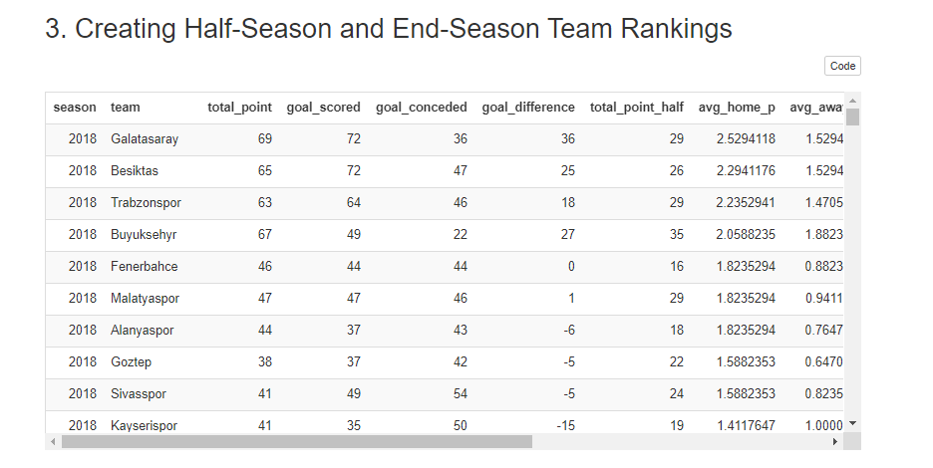

Slide 5
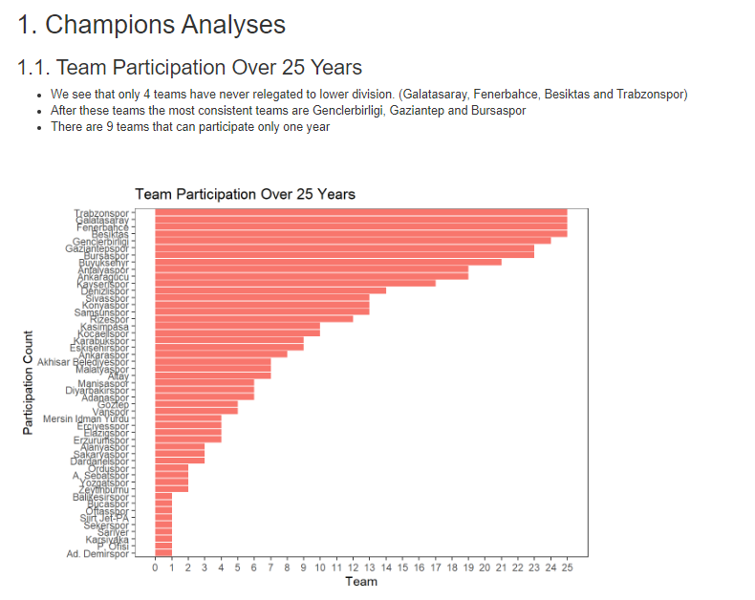

Slide 6
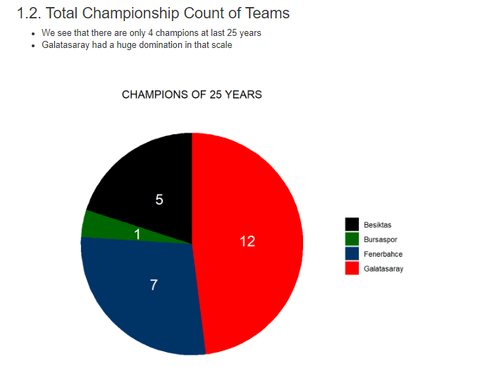

Slide 7
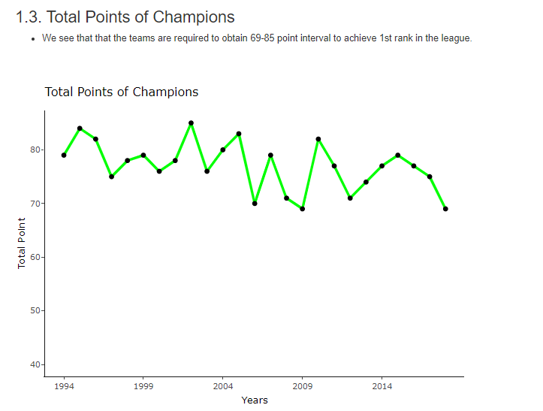

Slide 8
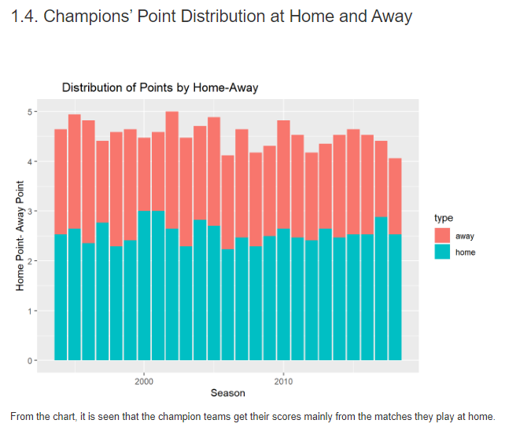

Slide 9
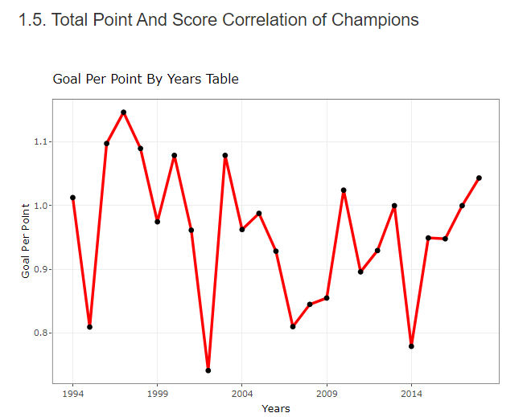

Slide 10
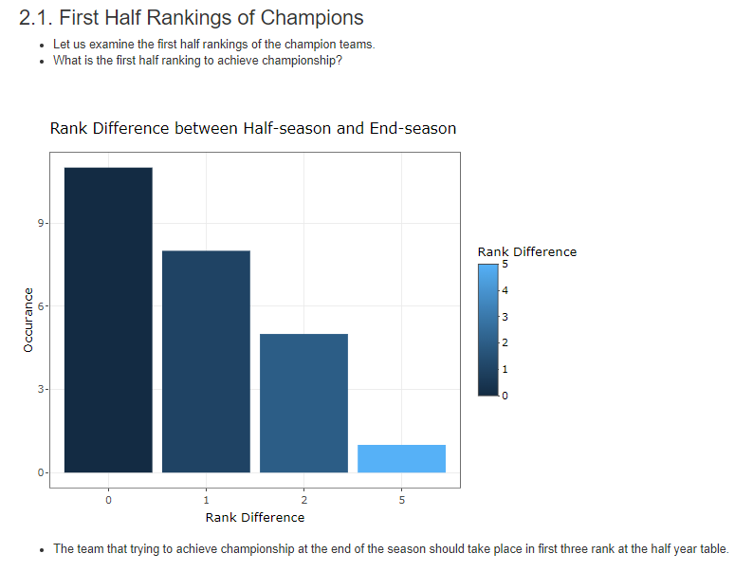

Slide 11
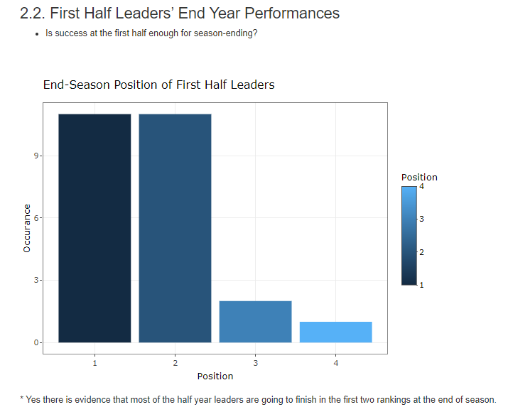

Slide 12
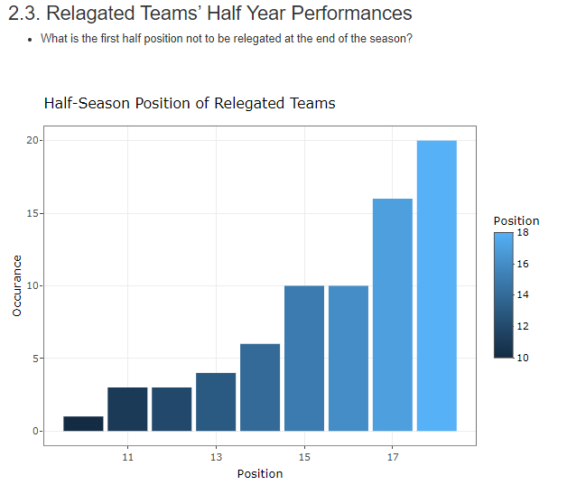

Slide 13
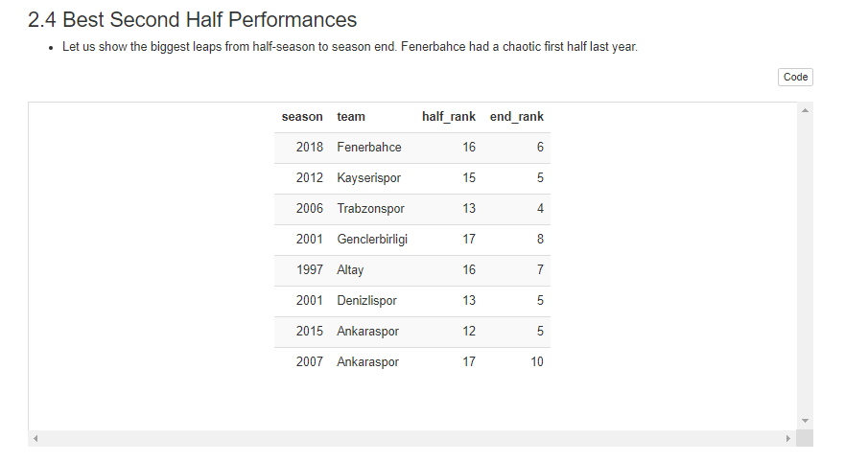

Slide 14
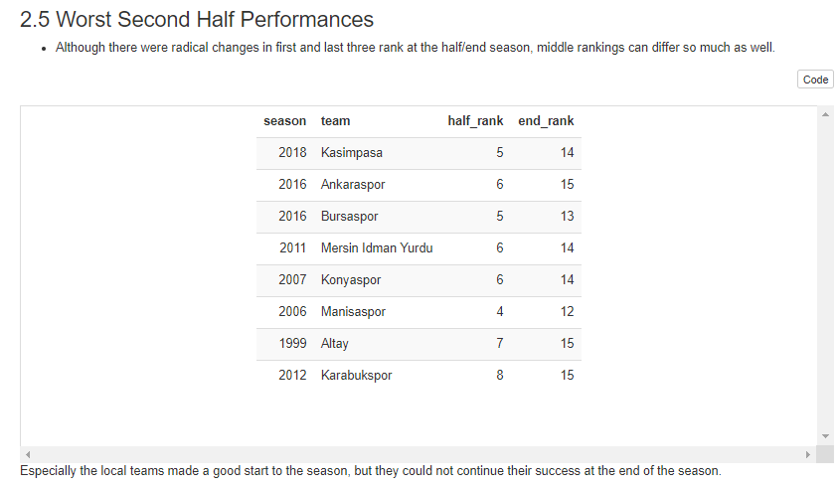

Slide 15
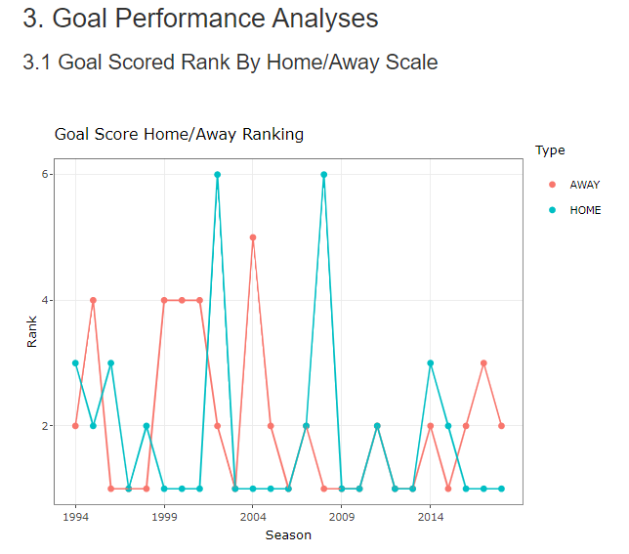

Slide 16
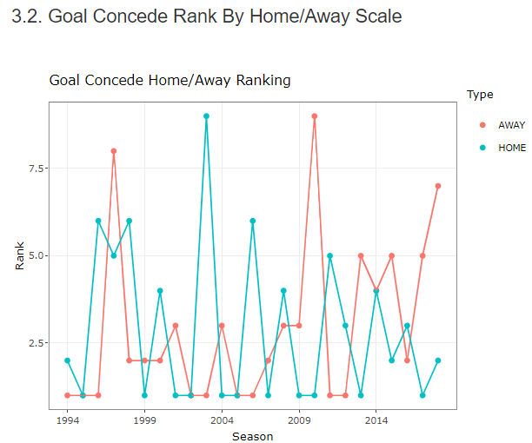

Slide 17
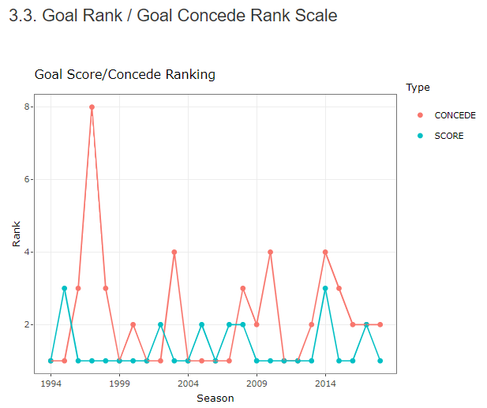

Slide 18
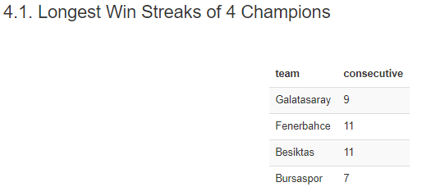
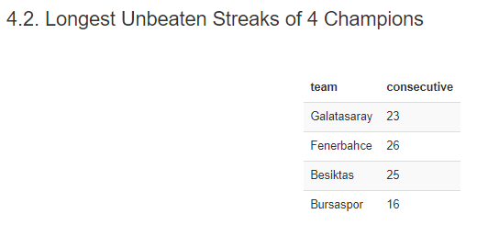
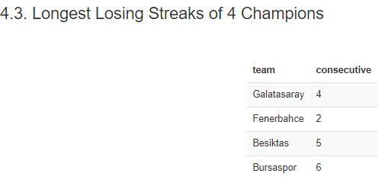

Slide 19
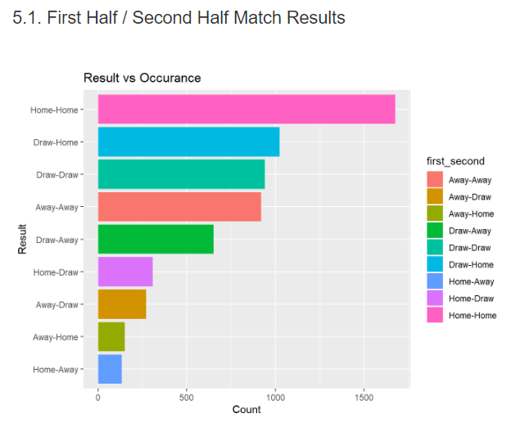

Slide 20
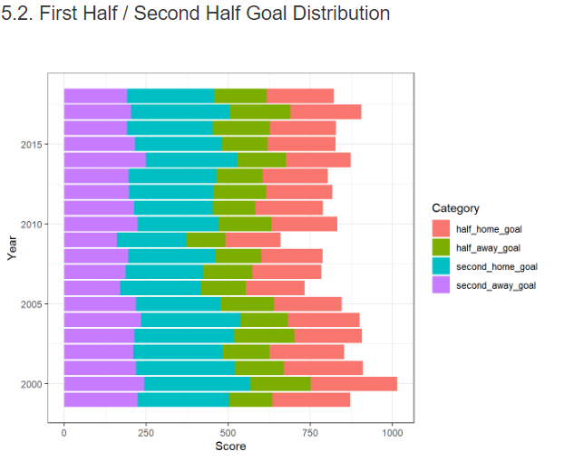

Slide 21
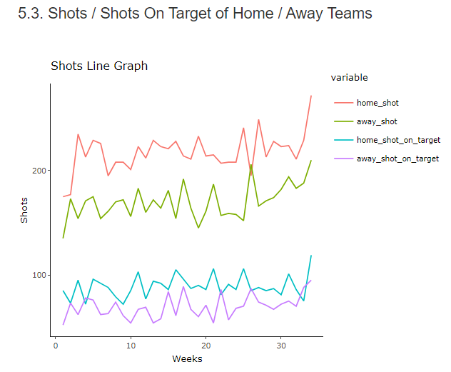

Slide 22
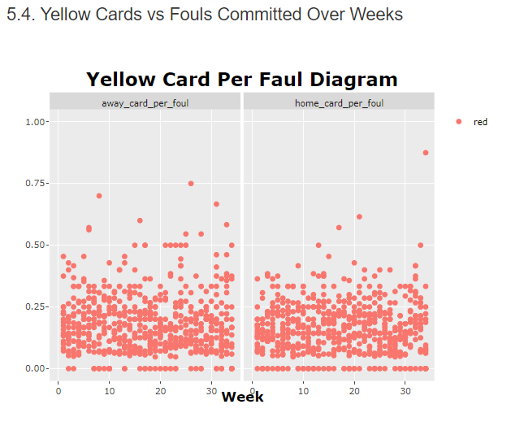

Slide 23
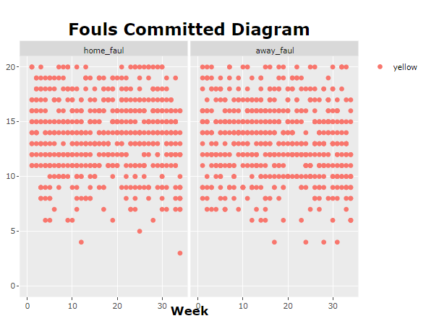

Slide 24
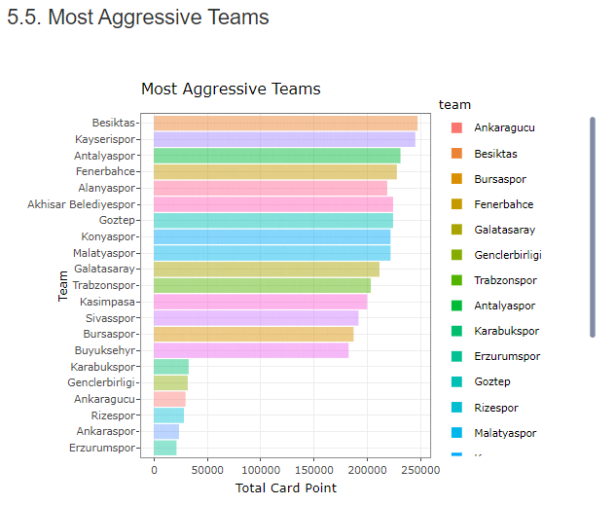

Slide 25
D.Concluison
* In the last 25 years, 49 teams have managed to attend the Turkish Super League at least once and 18 of these teams could stay in the league above the average (9 times).
* Throughout 25 years, only 4 teams succeeded to be champion and total points of those fluctuates between 69-85 points interval.
* Champion teams scored more point in their home matches than away matches. In general, we have concluded that the teams are better, when playing in their home.
* The teams that won the championship at the end of the season were take place in first three rank at the half year table. There is evidence that most of the half year leaders are going to finish in the first two rankings at the end of season.
* Mostly, champion teams are on the first rank at total scored goal and a team is more likely to become a champion, when that team scores more goal than others.
* Total scored goal number is a more decisive factor than total conceded goal number.
* Local teams, below average-attending, failed to continue despite a good start to the season.

